Slide 1
SAMSUNG GLOBAL SALES PERFORMANCE DASHBOARD
Submitted By: Farzana PA

Slide 2
INTRODUCTION
The global electronics market is highly competitive, with companies focusing on innovation, pricing strategies, and customer satisfaction.
This project analyzes the Samsung Global Sales dataset to understand business performance across different regions, products, and customer segments.
The dashboard provides insights into:
Revenue and profit trends
Product performance
Sales channel distribution
Customer behavior

Slide 3
OBJECTIVES
Analyze overall sales performance and trends
Identify top-performing products and categories
Evaluate profitability and revenue distribution
Understand customer segments and sales channels
Provide insights for business decision-making

Slide 4
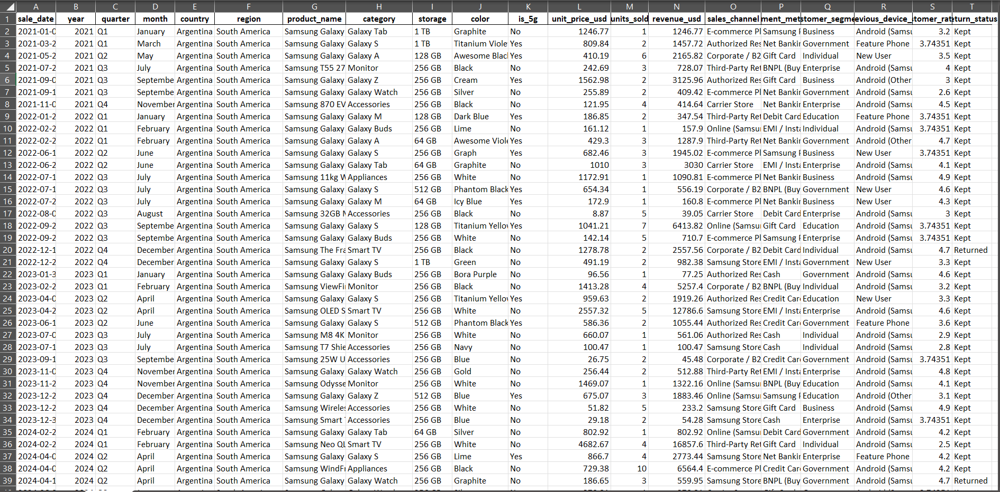
DATASET USED

Slide 5
DATASET
The dataset contains detailed sales information of Samsung products across multiple countries.
Key Details:
Rows:15,500
Columns: 21
Important Columns:
Date, Year, Month
Country, Region
Product, Category
Unit Price, Units Sold
Revenue, Profit
Sales Channel
Customer Segment
Customer Rating
Return Status

Slide 6
PIVOT TABLES
Revenue By Customer Segment
Monthly Revenue Trend
Revenue vs Profit by Month
Top 10 Products By Revenue
Row Labels | Sum of Revenue
January | 2044209.91
February | 1640535.2
March | 1827762.45
April | 1850411.77
May | 1959111.57
June | 2099161.62
July | 1841931.21
August | 1942453.29
September | 1866744.03
October | 2096938.93
November | 1808459.09
December | 1933539.81
Row Labels | Sum of Profit | Sum of Revenue
January | 515506.664 | 2044209.91
February | 421949.258 | 1640535.2
March | 475045.532 | 1827762.45
April | 475739.121 | 1850411.77
May | 509594.487 | 1959111.57
June | 543360.261 | 2099161.62
July | 474975.312 | 1841931.21
August | 504255.368 | 1942453.29
September | 482487.877 | 1866744.03
October | 542771.903 | 2096938.93
November | 457889.331 | 1808459.09
December | 495373.493 | 1933539.81
Row Labels | Sum of Revenue
Samsung Galaxy Tab S9 Ultra | 613184.18
Samsung The Frame 55-inch | 618187.82
Samsung Odyssey Neo G9 | 651827.53
Samsung ViewFinity S9 | 746484.03
Samsung Galaxy Z Fold 4 | 763137.3
Samsung Galaxy Z Fold 5 | 858492.72
Samsung Neo QLED 4K QN85C | 859697.3
Samsung French Door Refrigerator | 914370.15
Samsung OLED S95C 65-inch | 1222086.81
Samsung Neo QLED 8K QN900C | 2231009.59
Row Labels | Sum of Revenue
Business | 4545605.07
Education | 4481623.94
Enterprise | 4491693.89
Government | 4748703.9
Individual | 4643632.08

Slide 7
Revenue Distribution By Country
Row Labels | Sum of Revenue
Argentina | 455726.16
Australia | 437532.39
Austria | 529642.09
Bangladesh | 484306
Belgium | 361647.5
Brazil | 404509.74
Canada | 515495.34
Chile | 463495.6
China | 380012.21
Colombia | 441768.22
Czech Republic | 444956.19
Denmark | 421990.1
Egypt | 439261.56
Ethiopia | 391058.82
France | 522563.49
Germany | 429448.96
Greece | 551966.07
India | 468730.51
Indonesia | 459696.89
Italy | 442618.87
Japan | 416493.84
Kenya | 445910.1
Malaysia | 414316.55
Mexico | 401877.13
Myanmar | 405469.64
Netherlands | 373662.73
New Zealand | 377018.99
Nigeria | 485044.72
Norway | 522623.37
Pakistan | 480871.03
Peru | 354245.98
Philippines | 371469.98
Poland | 407587.07
Portugal | 414825.94
Romania | 406326.65
Russia | 386479.27
Saudi Arabia | 353226.52
Singapore | 387462.27
South Africa | 462616.55
South Korea | 509915.68
Spain | 442939.82
Sri Lanka | 492857.08
Sweden | 406149.44
Switzerland | 378224.96
Taiwan | 500483.33
Thailand | 474783.27
Turkey | 479950.45
UAE | 533780.97
Ukraine | 436132.92
United Kingdom | 409797.85
United States | 446275.97
Vietnam | 486012.1
Revenue By Category
Row Labels | Sum of Revenue
Accessories | 234760.98
Appliances | 2253734.4
Galaxy A | 1154772.22
Galaxy Buds | 298759.24
Galaxy M | 425853.53
Galaxy S | 4728112.37
Galaxy Tab | 2451712.69
Galaxy Watch | 913148.29
Galaxy Z | 2765867.41
Monitor | 2125195.2
Smart TV | 5559342.55
Sales Channel Distribution
Row Labels | Sum of Revenue
Authorized Reseller | 3109133.95
Carrier Store | 3212142.04
Corporate / B2B | 3346952.28
E-commerce Platform | 3369992.99
Online (Samsung.com) | 3155638.03
Samsung Store | 3432361.37
Third-Party Retailer | 3285038.22

Slide 8
Pivot tables were created to summarize and analyze data:
Monthly Revenue Trend
Revenue vs Profit by Month
Top 10 Products by Revenue
Sales Channel Distribution
Category-wise Revenue
Pivot tables helped in:
Easy filtering
Data grouping
Dashboard visualization

Slide 9
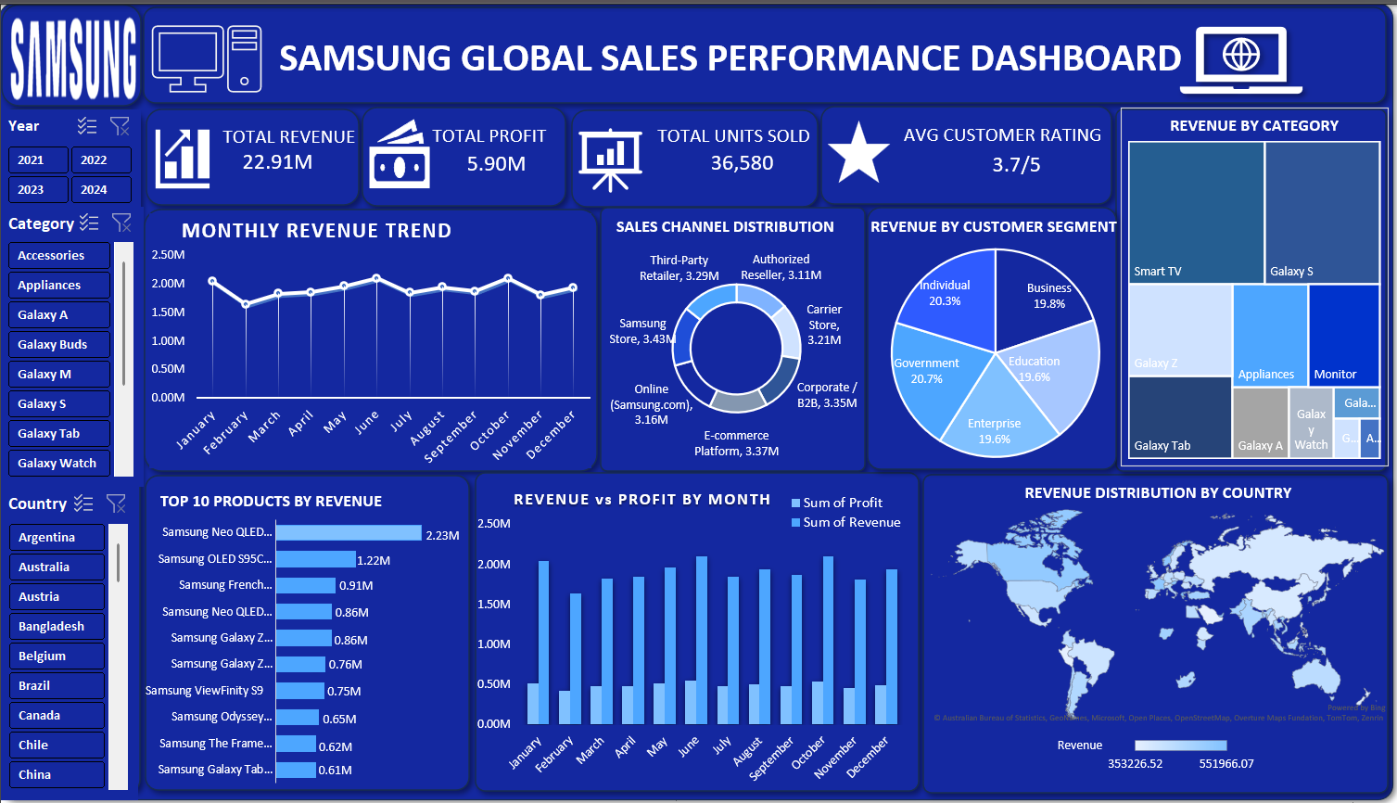
DASHBOARD

Slide 10
CRITERIA USED IN THIS PROJECT
Dashboard Overview
Interactive dashboard for sales analysis
Uses pivot tables and slicers
Provides overall business insights
Filters (Slicers)
Used for dynamic data filtering
Includes Year, Country, Category
Improves interactivity and user control

Slide 11
KPI Metrics
Total Revenue → overall sales performance
Total Profit → profitability measure
Total Units Sold → sales volume
Avg Customer Rating → customer satisfaction
Charts Used
Line Chart:Monthly Revenue Trend → shows sales trend over time
Column Chart:Revenue vs Profit → compares revenue and profitability
Bar Chart:Top 10 Products → identifies best-performing products
Doughnut Chart:Sales Channel Distribution → shows contribution of channels
Pie Chart:Customer Segment Analysis → shows customer type distribution
Treemap:Revenue by Category → shows category-wise performance
Map Chart:Country-wise Sales → shows regional performance

Slide 12
CONCLUSION
This dashboard provides insights into Samsung’s global sales performance.
Key findings:
Certain products contribute significantly to revenue
Some regions generate high sales but moderate profit
Sales channels impact overall performance
Customer segments show different purchasing patterns

Slide 13
SUGGESTIONS
Focus on high-profit products
Optimize low-performing regions
Improve pricing strategy
Strengthen online sales channels
Enhance customer satisfaction

Slide 14
THANK YOU

